Slide 1
API & Spring Framework

Slide 2
Contents
Clean Architecture Overview

Slide 3
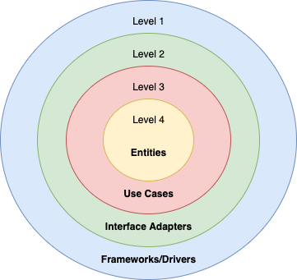
Clean Architecture Overview
Clean Architecture is a guideline to a high maintainable code, considering all the uncertainties around us.
The core idea is to divide the system into levels based on the business value.

Slide 4
Clean Architecture Overview

